Slide 1


SalzGuide
by MMT Students

Slide 2




Problem
Minimal pre-arrival research.
Tourists start discovering Salzburg only once they arrive.

Slide 3
Solutions
Platform Integration
Search Engine Marketing
SalzGuide Platform
Post-booking call-to-action

Slide 4
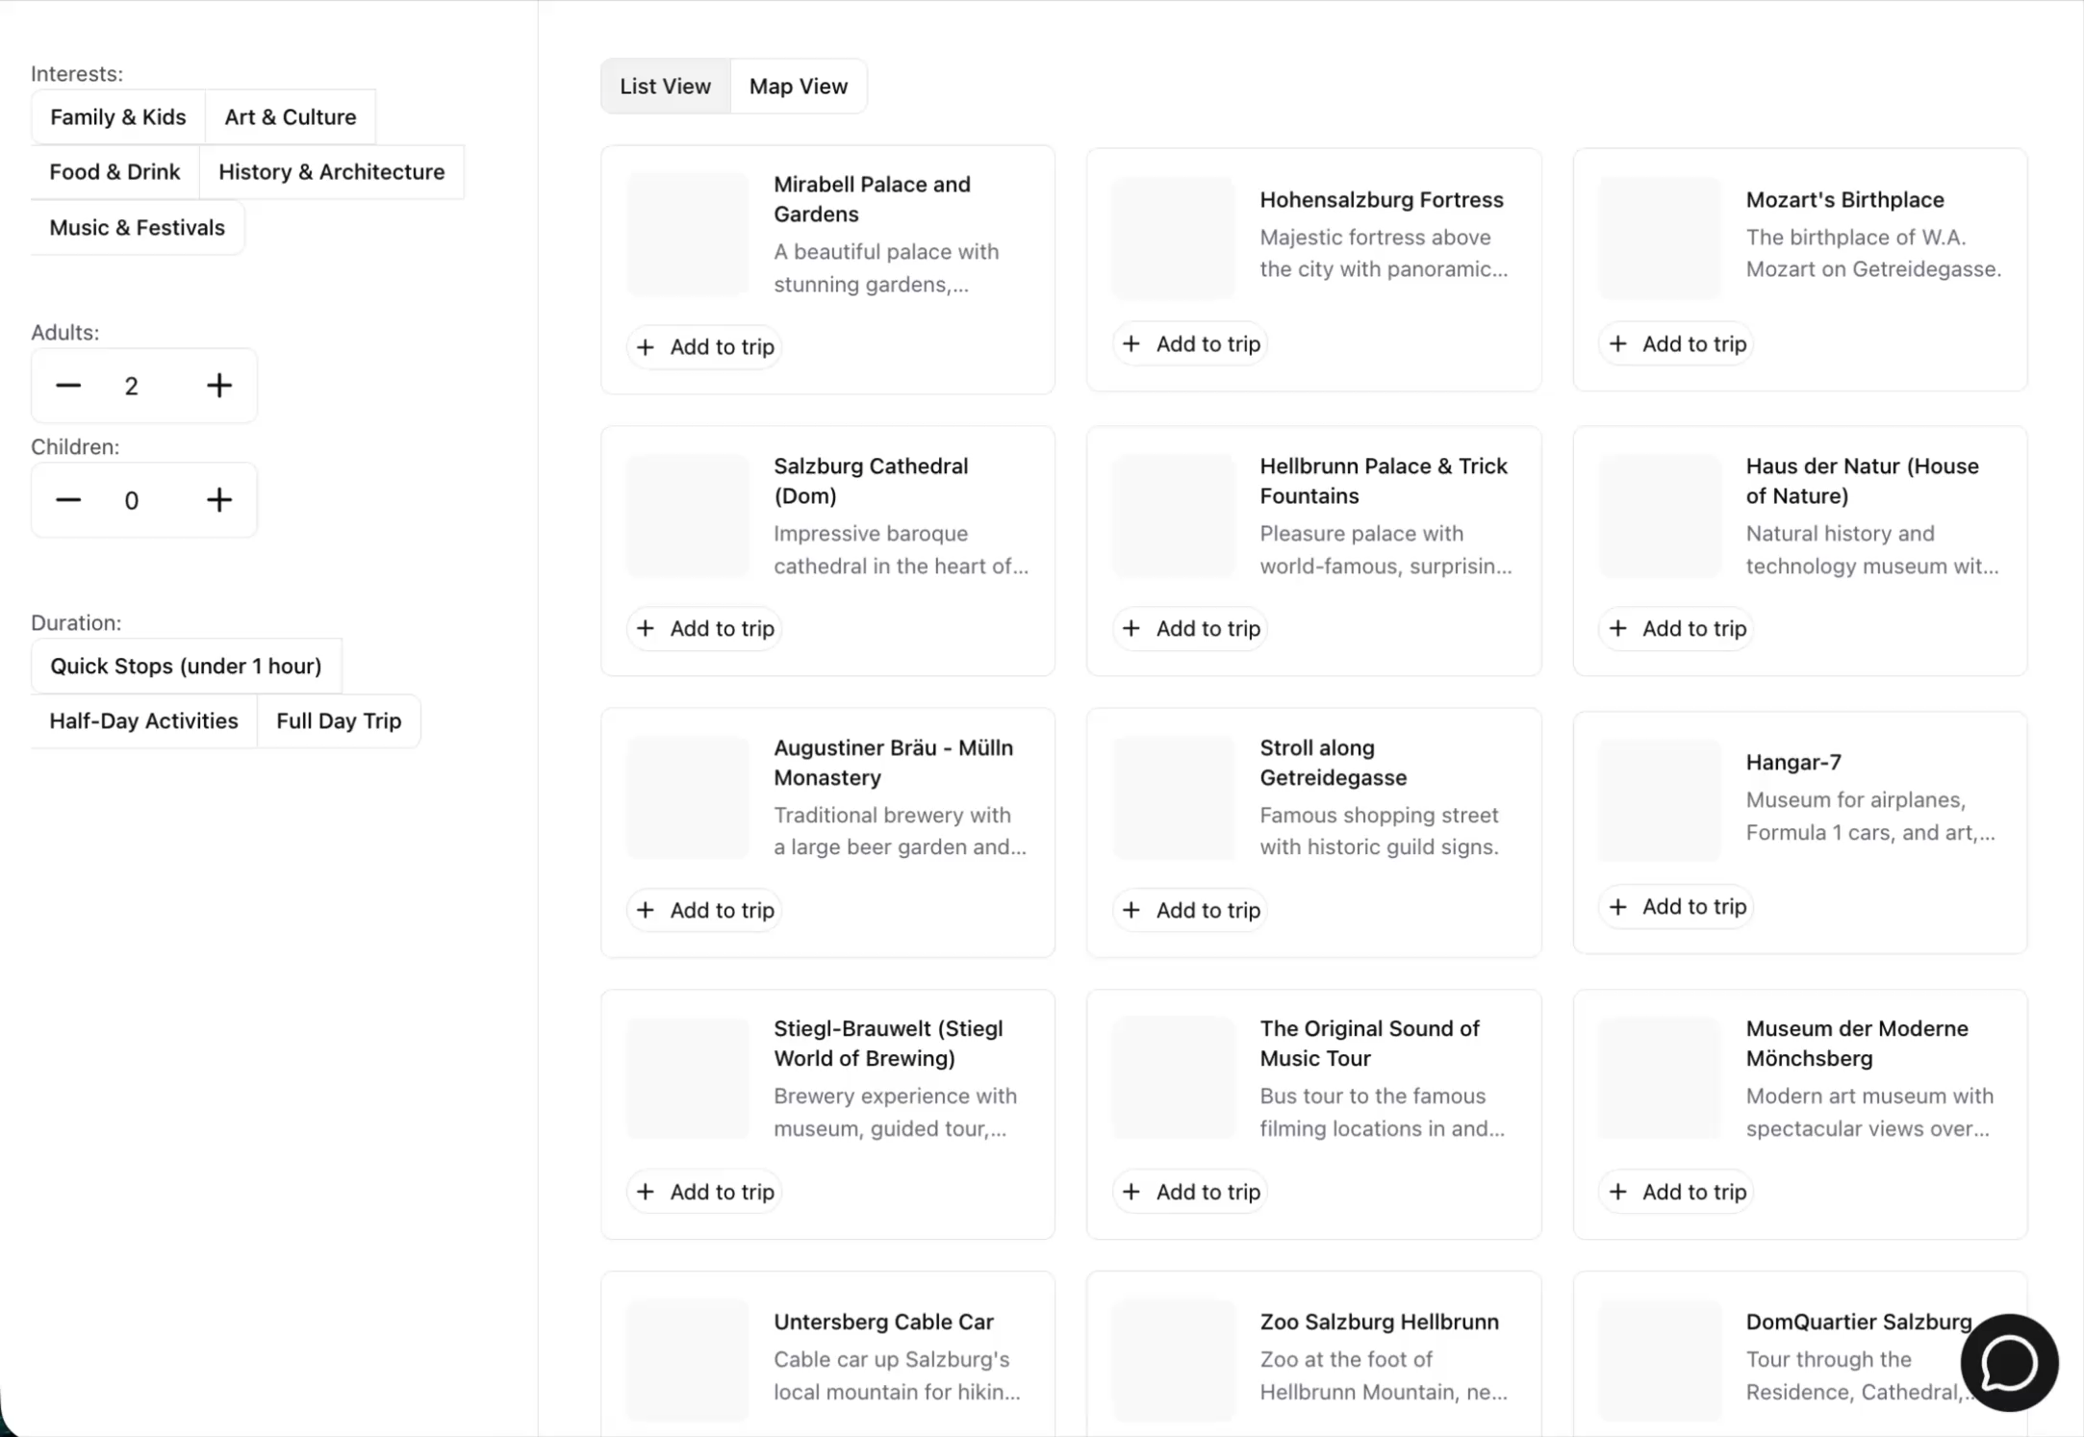
Demo Filter

Slide 5
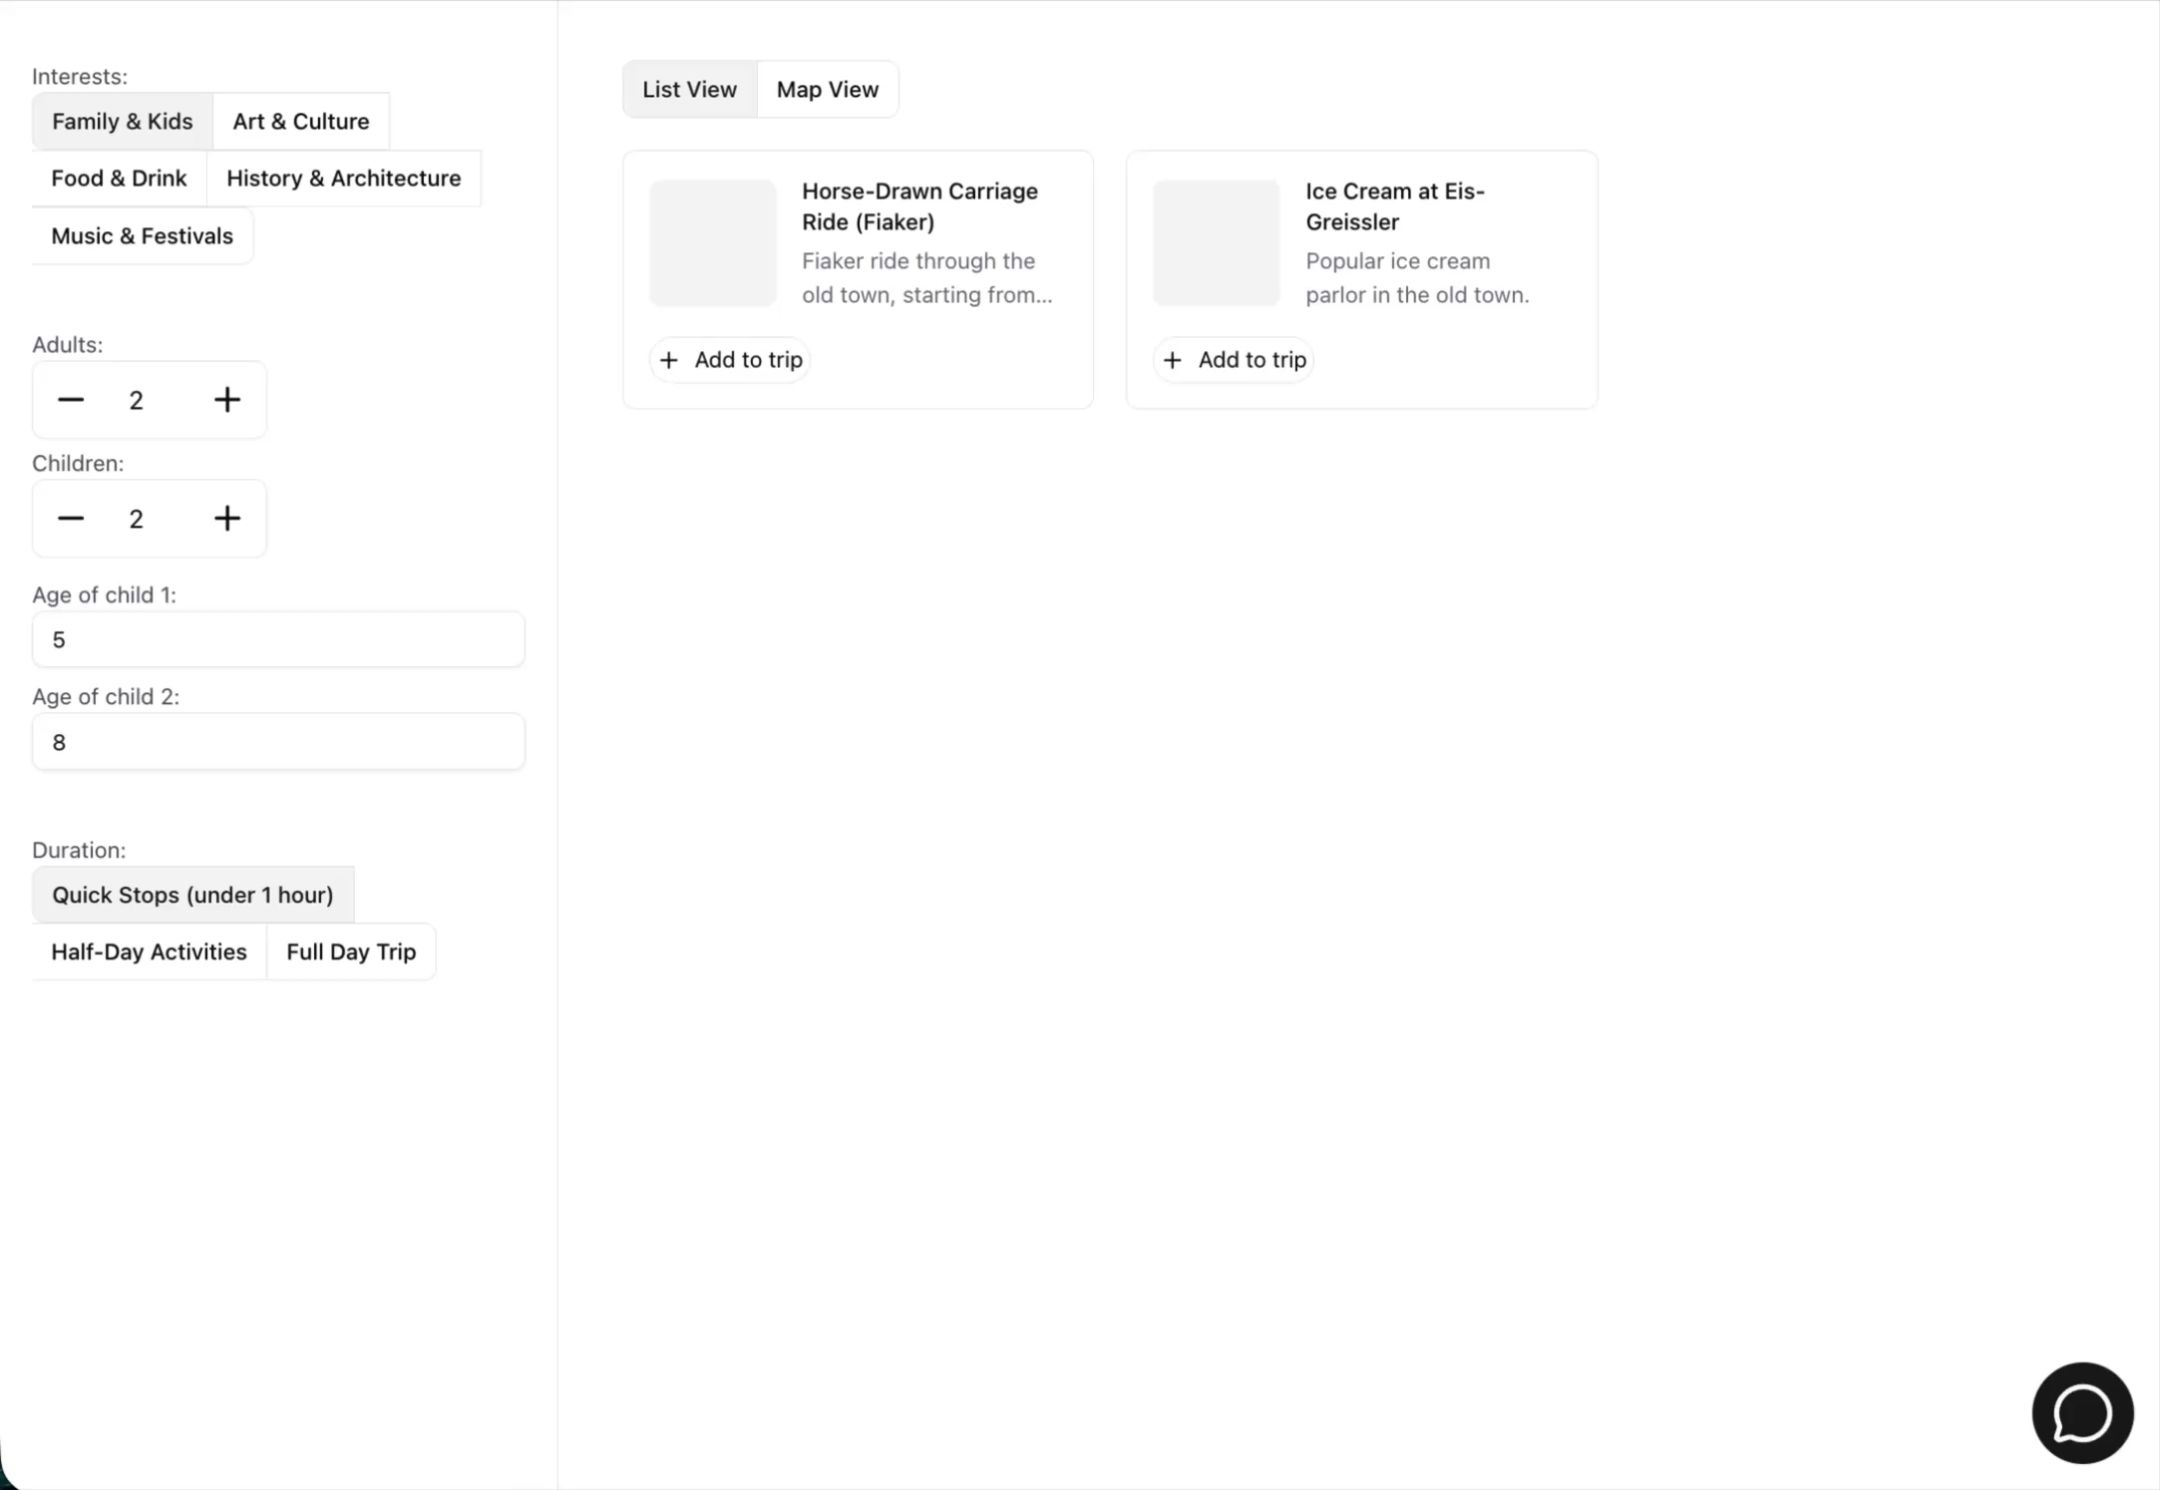
Demo Map

Slide 6
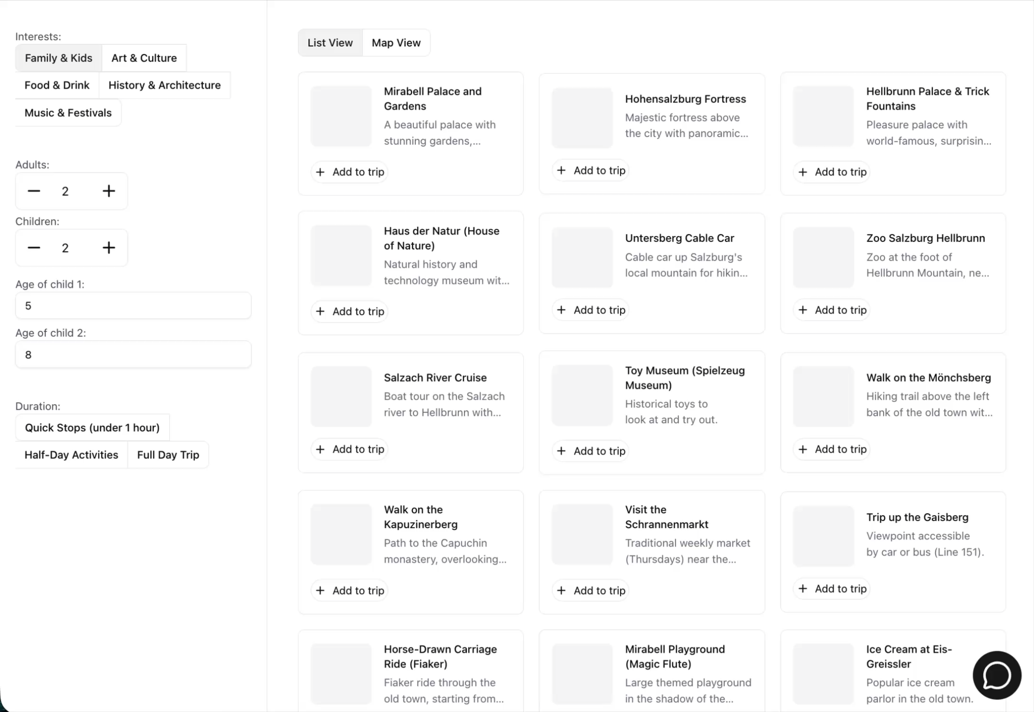
Demo Chatbot

Slide 7
Next Steps
Collect & structure real-world data
Develop smart recommendation algorithm

Slide 8

COme visit Salzburg

